Slide 1

Deeply Virtual Compton Scattering on the neutron with CLAS12 at 11 GeV
k’
k
q’
n
GPDs
n’
Silvia Niccolai for the CLAS Collaboration
PAC37, Jefferson Lab , January 13 2011

Slide 2










Deeply Virtual Compton Scattering on the neutron with CLAS12 at 11 GeV
Saclay
and the CLAS collaboration
Co-spokespersons: A. El Alaoui (Argonne), M. Mirazita (INFN Frascati),
S. Niccolai (IPN Orsay), V. Kubarovsky (Jefferson Lab)

Slide 3
Deeply Virtual Compton Scattering and GPDs
e’
~
~
GPDs: H, E, H, E
Fully correlated quark and spin distributions in both coordinate and momentum space
e
t
γ
γ*
(Q²)
x+ξ
x-ξ
~
~
H, H, E, E (x,ξ,t)
4 GPDs for each quark flavor
two conserving nucleon spin, two flipping nucleon spin:
Vector: H (x,ξ,t)
Tensor: E (x,ξ,t)
Axial-Vector: H (x,ξ,t)
Pseudoscalar: E (x,ξ,t)
Connected to elastic form factors and ordinary PDFs
N
N’
ξ ≅ x_{B}/(2-x_{B})
« Handbag » factorization valid
in the Bjorken regime
~
~
Quark angular momentum (Ji’s sum rule)
1
1
1
[
]
J
q
=
− J^{G} =
∫
xdx
H
q
(
x
,
ξ
,
0
)
+
E
q
(
x
,
ξ
,
0
)
2
2
−
1
X. Ji, Phy.Rev.Lett.78,610(1997)
Notes:
At twist 2 and leading order there are 4 GPDS. Spin crises instead of puzzle.

Slide 4
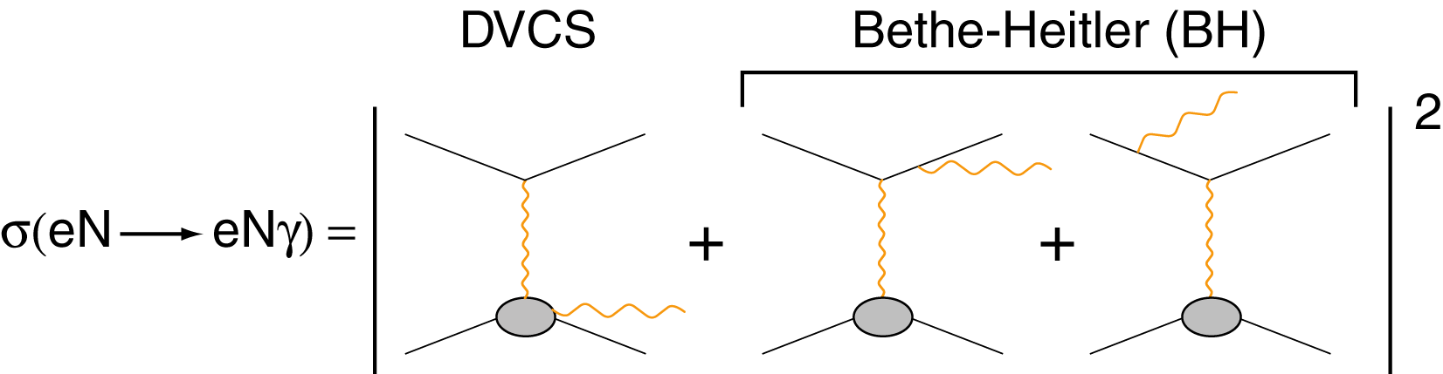
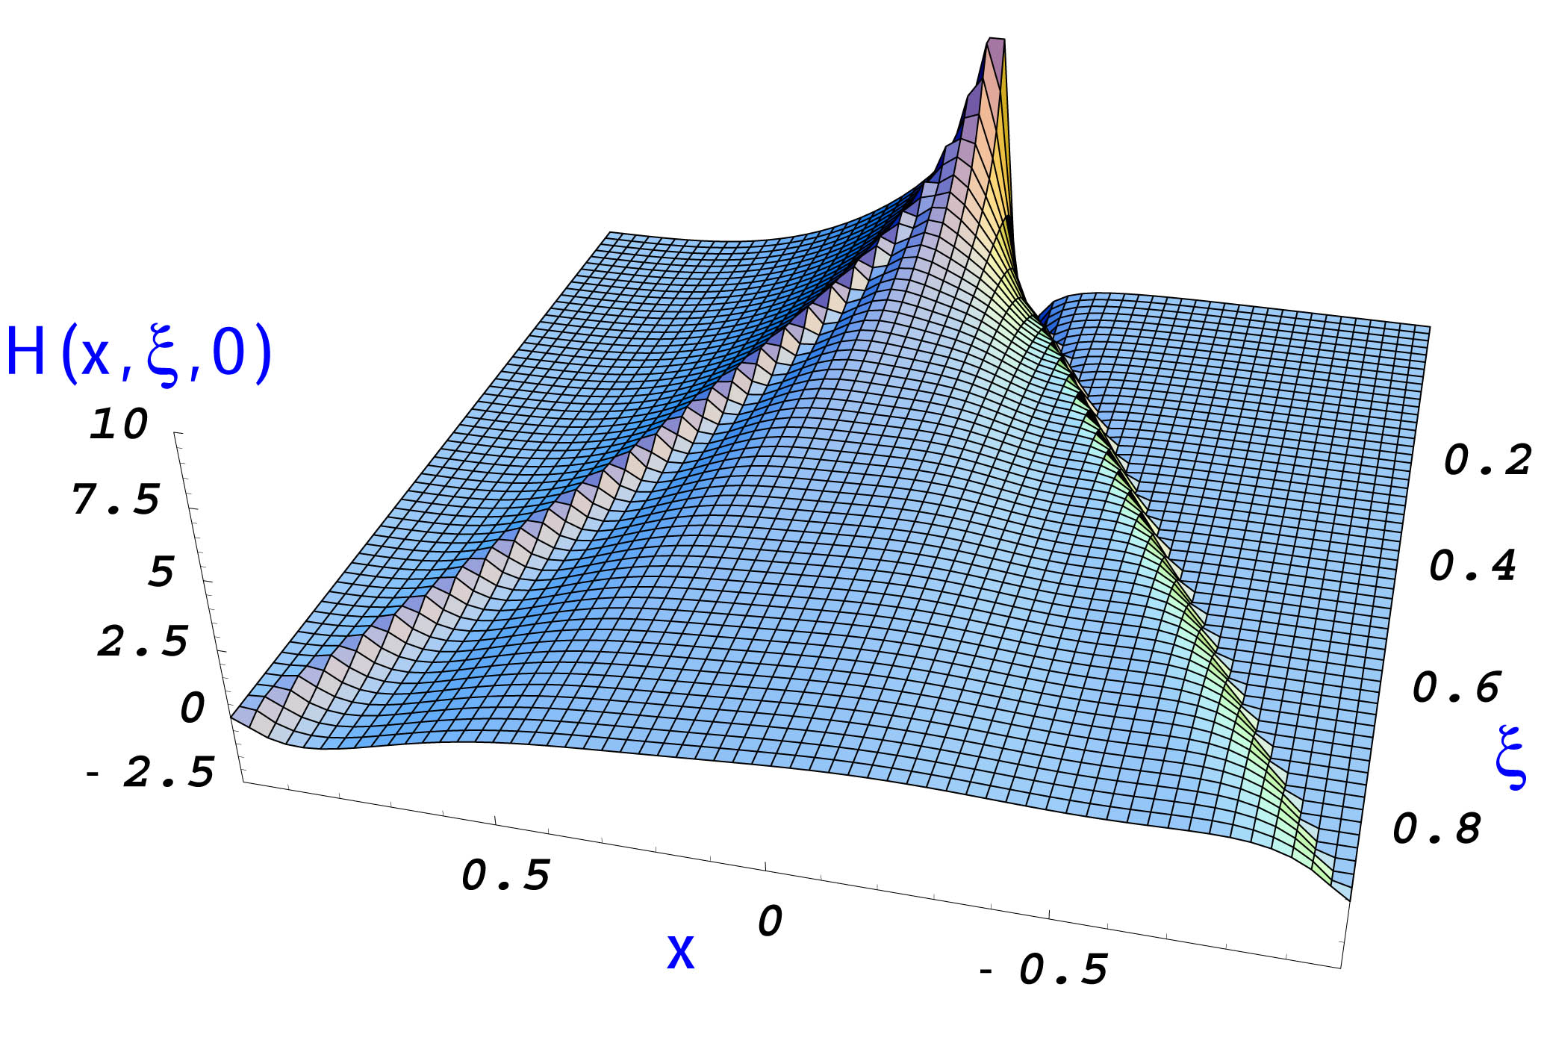
Accessing GPDs through DVCS
σ~ |T^{DVCS} +T^{BH}|²
Δσ = σ⁺ − σ ⁻ ∝ I(DVCS·BH)
Δσ
I(DVCS·BH)
A = ∝
2σ
|BH|²+|DVCS|²+I
Δσ
Only ξ and t
are accessible
experimentally
σ
Notes:
BH is well known and calculable from FF. Real part accessible with DSA as well.

Slide 5
Sensitivity to GPDs of DVCS spin observables
γ
e’
φ
e
leptonic plane
N’
hadronic
plane
ξ= x_{B}/(2-x_{B}) k=-t/4M²
Proton Neutron
Polarized beam, unpolarized target:
~
Im{H_{p}, H_{p}, E_{p}}
~
Δσ_{LU} ~ sinφ Im{F₁H + ξ(F₁+F₂)H -kF₂E}dφ
~
Im{H_{n}, H_{n}, E_{n}}
Unpolarized beam, longitudinal target:
~
~
~
Im{H_{p}, H_{p}}
Δσ_{UL} ~ sinφIm{F₁H+ξ(F₁+F₂)(H + x_{B}/2E) –ξkF₂ E+…}dφ
~
Im{H_{n}, E_{n}, E_{n}}
~
Polarized beam, longitudinal target:
Re{H_{p}, H_{p}}
~
Δσ_{LL} ~ (A+Bcosφ)Re{F₁H+ξ(F₁+F₂)(H + x_{B}/2E)…}dφ
~
Re{H_{n}, E_{n}, E_{n}}
Unpolarized beam, transverse target:
Im{H_{p}, E_{p}}
Δσ_{UT} ~ sinφIm{k(F₂H – F₁E) + ….. }dφ
Im{H_{n}}
Notes:
nDVCS complements pDVCS for the different sensitivity to GPDs of the various observables

Slide 6
DVCS measurements at JLab
GPDs Reaction Obs. Expt. E_{e} Status
ep→epγ BSA CLAS 4.2 GeV Published PRL
BSA CLAS 4.8- 5.75 GeV Published PRC
(σ, Δσ) Hall A 5.75 GeV Published PRL
BSA CLAS 5.75 GeV Published PRL
ep→epγ TSA (L) CLAS 5.65 GeV Published PRL
(longitudinal) TSA (L) CLAS 5.9 GeV Analysis ongoing
DSA(L) CLAS 5.9 GeV Analysis ongoing
ep→epγ TSA (T) CLAS 6 GeV Data taking this year
en→enγ Δσ Hall A 5.75 GeV Published PRL
ep(n)→ep(n)γ σ Hall A 4.82/6 GeV Data just taken
For JLab@12 GeV, approved DVCS experiments:
CLAS12: BSA and TSA (longitudinal target) on the proton
Hall A for Δσ (polarized beam) on the proton
No experiments have been so far proposed for DVCS on the neutron at 11 GeV

Slide 7
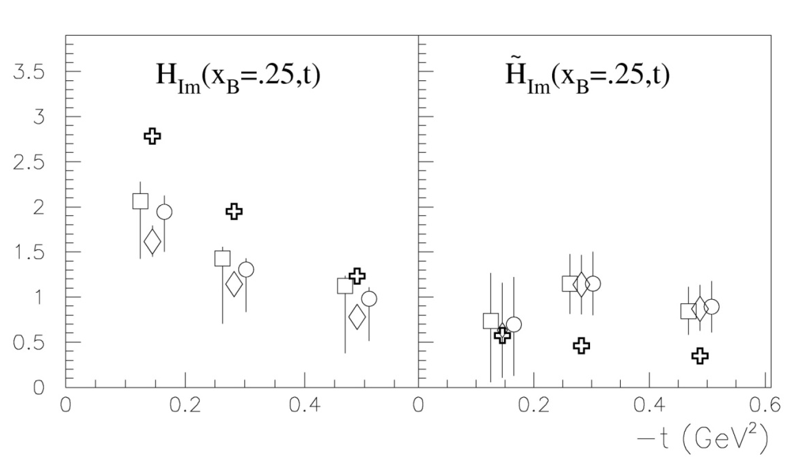
What we learn from the CLAS data
Fit of CLAS proton-DVCS BSAs and longitudinal TSA
Fit at fixed x_{B}, t, Q² of DVCS observables to extract CFFs using twist-2 LO DVCS/BH amplitude
7 CFFs
(different
bounds)
~
H, H
VGG
M. Guidal, PLB 689, 156 (2010)
Few observables available: model-dependent assumptions still necessary
No flavor separation possible at this stage

Slide 8
Flavor separation of GPDs
GPDs depend on quark flavor:
proton and neutron GPDs are linear combinations of quark GPDs
(H,E)_{p}(ξ, ξ, t) = 4/9 (H,E)_{u}(ξ, ξ, t) + 1/9 (H,E)_{d}(ξ, ξ, t)
(H,E)_{n}(ξ, ξ, t) = 1/9 (H,E)_{u}(ξ, ξ, t) + 4/9 (H,E)_{d}(ξ, ξ, t)
Combined analysis of DVCS observables for proton and neutron targets is necessary to perform a flavor separation of GPDs
(H,E)_{u}(ξ, ξ, t) = 9/15[4(H,E)_{p}(ξ, ξ, t) – (H,E)_{n}(ξ, ξ, t)]
(H,E)_{d}(ξ, ξ, t) = 9/15[4(H,E)_{n}(ξ, ξ, t) – (H,E)_{p}(ξ, ξ, t)]
Measurements of DVCS on neutron target are crucial for the completion
of a comprehensive GPD program for JLab@12 GeV
Notes:
Say for valence quarks only

Slide 9
BSA for DVCS at 11 GeV: sensitivity to E
DVCS on the proton
J_{u}=.3, J_{d}=.1
Δσ_{LU}/σ
J_{u}=.1, J_{d}=.1
J_{u}=.5, J_{d}=.1
J_{u}=.3, J_{d}=.3
J_{u}=.3, J_{d}=-.1
φ= 60°
x_{B} = 0.2
Q² = 2 GeV²
t = -0.2 GeV²
VGG Model
(calculations
by M. Guidal)
E_{e} = 11 GeV

Slide 10
BSA for DVCS at 11 GeV: sensitivity to E
DVCS on the neutron
J_{u}=.3, J_{d}=.1
Δσ_{LU}/σ
J_{u}=.1, J_{d}=.1
J_{u}=.5, J_{d}=.1
J_{u}=.3, J_{d}=.3
J_{u}=.3, J_{d}=-.1
φ= 60°
x_{B} = 0.17
Q² = 2 GeV²
t = -0.4 GeV²
VGG Model
(calculations
by M. Guidal)
E_{e} = 11 GeV
The beam-spin asymmetry for nDVCS is:
very sensitive to E
depends strongly on the kinematics → wide coverage needed
maximum at low x_{B} → 11 GeV beam energy is necessary

Slide 11
BSA for DVCS at 11 GeV: sensitivity to E
DVCS on the neutron
J_{u}=.3, J_{d}=.1
Δσ_{LU}/σ
J_{u}=.1, J_{d}=.1
We propose to initiate an experimental program of
DVCS on the neutron by measuring the beam-spin asymmetry
CLAS12 will provide the large acceptance and high luminosity to cover a wide phase space
The 11 GeV CEBAF electron beam allows to cover a large Q², x_{B}, t range
J_{u}=.5, J_{d}=.1
J_{u}=.3, J_{d}=.3
J_{u}=.3, J_{d}=-.1
φ= 60°
x_{B} = 0.17
Q² = 2 GeV²
t = -0.4 GeV²
VGG Model
(calculations
by M. Guidal)
E_{e} = 11 GeV
The beam-spin asymmetry for nDVCS is:
very sensitive to E
depends strongly on the kinematics → wide coverage needed
maximum at low x_{B} → 11 GeV beam energy is necessary

Slide 12
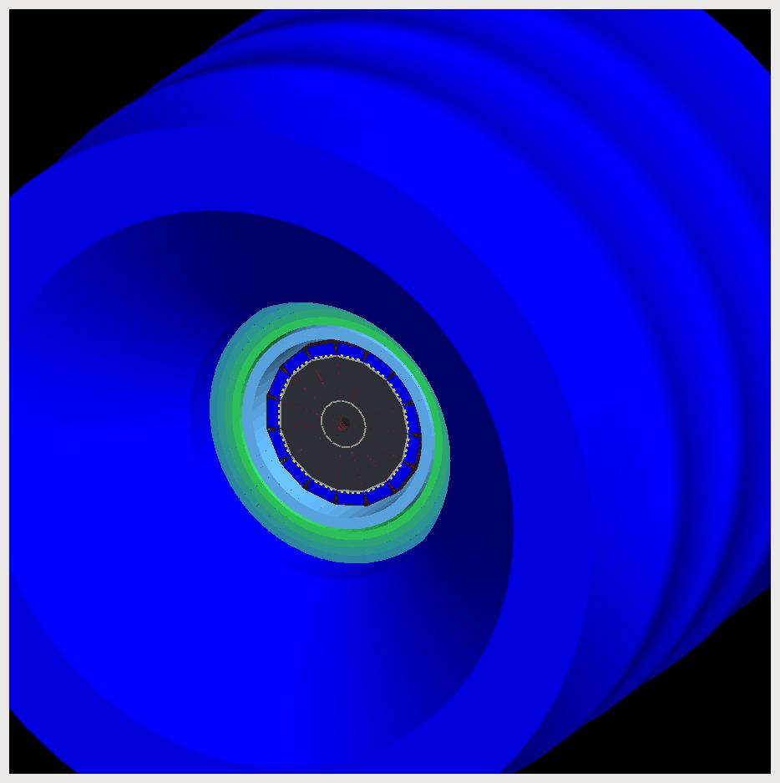
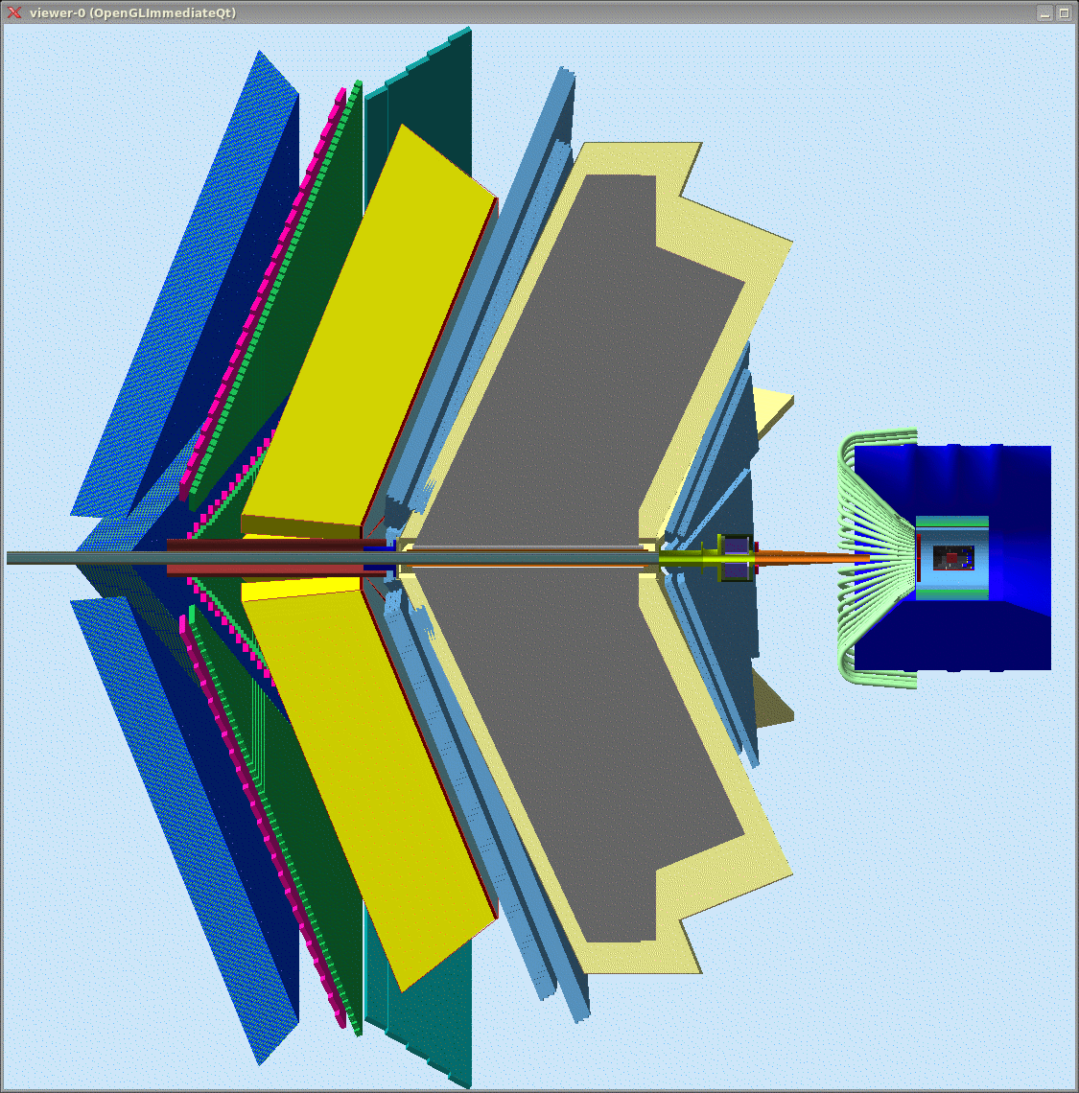
Neutron DVCS setup
For the detection of the scattered electron and of the DVCS photon: CLAS12 + Forward Calorimeter
CTOF
Central
Tracker
CTOF
DC
EC
CND
Central
Detector
For the detection of the recoil neutron: Central Neutron Detector (CND)
Acceptance for
charged particles:
Central (CD), 40º<θ<135º
Forward (FD), 5º<θ<40º
Forward
Calorimeter
LTCC
Acceptance for photons:
FC 2.5º<θ< 5º
EC, 5º<θ<40º
(HTCC removed
for clarity)

Slide 13
CND: requirements
<p_{n}>~ 0.4 GeV/c
Detected in
forward CLAS12
Not detected
ed→e’nγ(p)
Central Detector
Detected in CND
Detected in
EC, FC
p^{μ}_{e} + p^{μ}_{n} + p^{μ}_{p} = p^{μ}_{e′} + p^{μ}_{n′} + p^{μ}_{p′} + p^{μ}_{γ}
In the hypothesis of absence of FSI:
p^{μ}_{p} = p^{μ}_{p’} → kinematics are complete
detecting e’, n (p,θ,φ), γ
FSI effects will be estimated measuring
enγ, epγ, on deuteron
in this same experiment
and compare with free-proton data
More than 80% of the neutrons have θ>40°
→ Neutron detector in the CD
Resolution on MM(enγ) studied with nDVCS event generator + electron and photon resolutions obtained from CLAS12 FastMC
+ design specs for Forward Calorimeter
→ dominated by photon resolutions
→ The CND must ensure:
good neutron identification for 0.2<p_{n}≤1 GeV/c → σ(TOF) ~ 150 ps for n/γ β−separation
momentum resolution up to 10%
no stringent requirements for angular resolutions

Slide 14
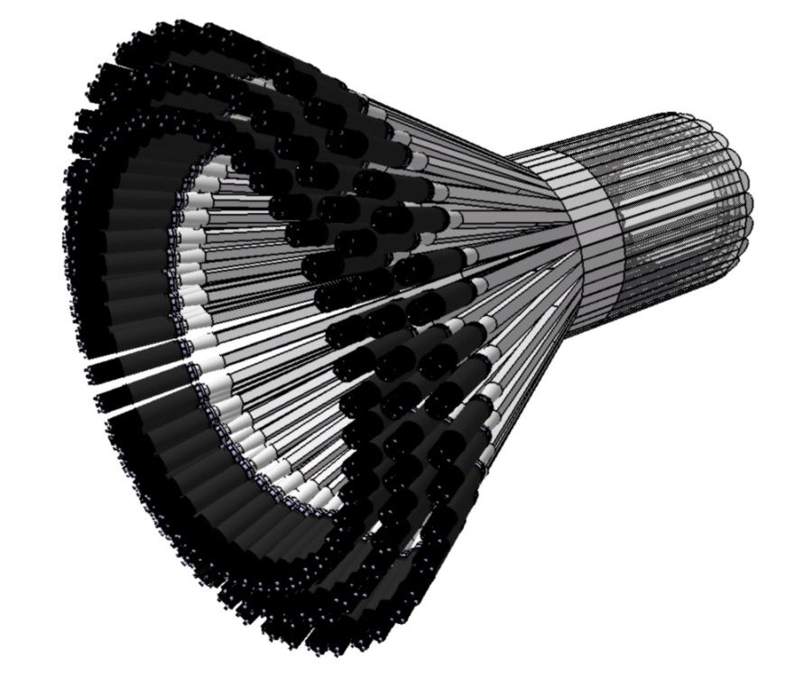
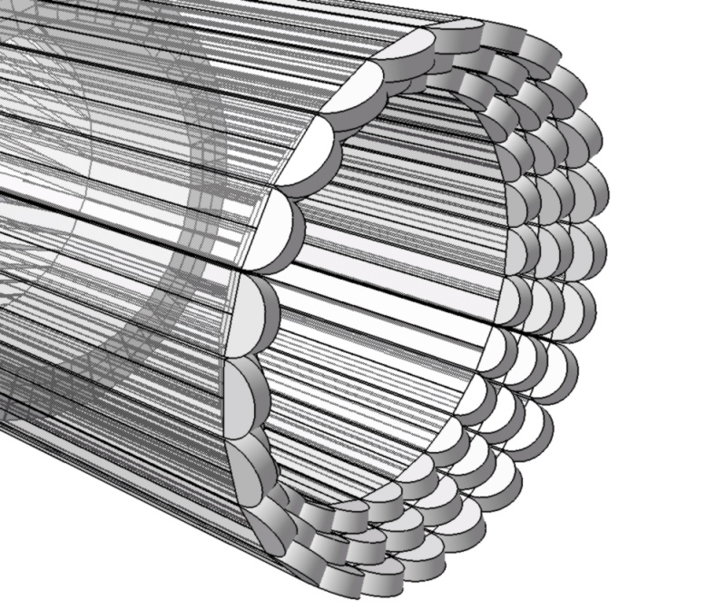
CND: constraints and chosen design
CTOF can also be used for neutron detection
Central Tracker (SVT+MM): veto for charged particles
limited space available (~10 cm thickness)
limited neutron detection efficiency
no space for light guides upstream
strong magnetic field (~5 T) → problems for light readout
Three kinds of B-field-resistant photodetectors tested: SIPMs, APDs, MCP-PMs
Final design: scintillator barrel
3 radial layers, 48 bars per layer
coupled two-by-two by “u-turn” lightguides
The light comes out only at the upstream side of the CND, goes through bent light guides (1.5m) arriving to ordinary PMTs, placed in the low-field region
Notes:
The detector segmentation has been chosen to optimize the matching between surfaces of scintillator and photocathodes of PMTs

Slide 15
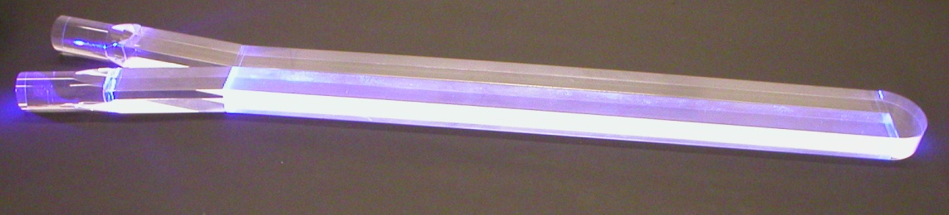
CND: performances
Efficiency for different thresholds on deposited energy
Efficiency ~ 8-10%
for a threshold of 2 MeV, TOF<8 ns
and p_{n} = 0.2 - 1 GeV/c
Efficiency
Momentum (GeV/c)
GEANT4 simulations done for:
efficiency
PID (neutron/photon separation)
momentum and angular resolutions
definition of reconstruction algorithms
background studies
Cosmic-rays measurements on a prototype
Measured values of σ(TOF) and light loss
due to u-turn implemented in the simulation
σ(TOF)
Hit position

Slide 16
CND: performances
Equal n/γ yields assumed
n/γ misidentification for p_{n} <1 GeV/c
Error bars on the β - axis represent 3 σ
β
p (GeV/c)
β
σ (θ)
Δp/p ~ 4-10%
Δθ ~ 2-4°
p (GeV/c)

Slide 17
Backgrounds in the CND
Electromagnetic background rates and spectra
in the CND have been studied with GEANT4:
After reconstruction cuts background rate ~ 30 KHz
Assuming a 1-KHz rate of eγ events in the CLAS12
rate of accidental coincidences ~ 0.05 Hz
Energy deposition in CND
of background photons
Physical background from photons coming from
asymmetric meson decays studied with DIS simulation and CLAS12 acceptance:
requiring an electron and a photon (Eγ>1 GeV) in the FD
applying “DVCS-like” cut MM(eγ)<1.1 GeV
assuming 30% of acceptance + efficiency for electron and photon in the CLAS12, and 10% photon efficiency in the CND
→ 0.6 Hz of photon rate on the CND
Expected integrated nDVCS-BH neutrons rate ~ 4 Hz

Slide 18
ed→enπ⁰(p) background
For each (Q², x_{B}, t, φ) bin, the background coming from enπ⁰(p) events,
where only one of the two π⁰ decay photons is detected,
will be subtracted in the analysis as follows:
Background contamination estimated using nDVCS-BH and ed→enπ⁰(p) generators + FASTMC (realistic CLAS12, FT and CND resolutions and acceptances): ~15% (19%)
FT
enπ⁰ generator: Regge-based model (Laget) reproducing Hall A and CLAS proton data at 6 GeV

Slide 19
nDVCS with CLAS12 + CND: count-rate estimate
Beam-spin asymmetry for nDVCS
N = ∆t ∆Q² ∆x ∆φ L Time R_{acc} E_{eff}
VGG predictions
L = 10³⁵cm⁻²s⁻¹ per nucleon
Time = 80 days
R_{acc}= bin-by-bin acceptance for eγ (10%-40%)
E_{eff} = neutron detection efficiency (10%)
Count rates computed with nDVCS+BH
event generator
+ CLAS12 acceptance from FastMC
+ CND efficiency from GEANT4 simulation
J_{u}=.3, J_{d}=.1
J_{u}=.1, J_{d}=.1
J_{u}=.3, J_{d}=.3
J_{u}=.3, J_{d}=-.1
<t> ≈ - 0.35 GeV²
<Q²> ≈ 2.75GeV²
<x> ≈ 0.225
• 4 bins in Q² 1.5, 2.75, 4.25, 7.5 GeV²
• 4 bins in −t 0.1, 0.35, 0.65, 1 GeV²
• 4 bins in x_{B} 0.1, 0.225, 0.375, 0.575
• 12 bins in φ, each 30º wide
588
accessible
bins
Δt = 0.3 GeV², ΔQ² =1.5 GeV²,
Δx_{B} = 0.15, Δφ = 30°

Slide 20
φ →
Projected
number of
counts/bin
and coverage
ΔN/N=0.05%-10%
The final grid will be optimized
depending on the actual value of the BSA

Slide 21
Summary of setup and beam-time request
Experimental setup:
CLAS12 + Forward Calorimeter
Liquid deuterium target
Central Neutron Detector
Plan for CND:
Spring 2011: finalize R&D, with tests on 3-layer
prototype and final mechanical design
2nd semester 2011: detailed engineering drawing
2012- first half of 2013: construction
2nd semester 2013: assembly
→ ready to be installed in the CD by spring 2014
The detector will be financed by the
proposing european institutions, with
a stronger contribution from IN2P3
Beam energy: 11 GeV
Beam polarization: 85%
Testing and commissioning 7 days
Production data taking at L = 10³⁵ cm⁻²s⁻¹/nucleon 80 days
Moeller polarimeter runs 3 days
Total requested
90 days

Slide 22
Conclusions
nDVCS is a key reaction for the JLab GPD experimental program: measuring its beam-spin asymmetry can give access to E and therefore to the quark total angular momentum
(via Ji’s sum rule), and it is a first step towards flavor separation of GPDs
A large kinematical coverage is necessary to sample the phase-space, as the BSA is expected to vary strongly and be maximum at low x_{B} → 11 GeV beam + CLAS12 are necessary
The detection of the recoil neutron ensures exclusivity, reduces background and keeps
systematic uncertainties under control
The nDVCS recoil neutrons are mostly going at large angles (θ_{n}>40°), therefore a neutron detector must be added to the CLAS12 Central Detector using the available space
Using scintillator as detector material, “u-turn” downstream and long light guides with PMTs upstream, detection of nDVCS neutrons with ~10% of efficiency and n/γ separation for p_{n} ≤ 1 GeV/c will be achieved in the CND
We request 90 days of polarized 11 GeV beam to initiate the nDVCS program at JLab@12 GeV by extracting for the first time the beam-spin asymmetry,
on a wide kinematical coverage

